Slide 1
Resampling and its Role in Time Series
Getting more out of your model.
Credit: /u/undercome
http://www.autobox.com/resample.pptx

Slide 2
About Our Presenter
B.B.A. in Statistics from CCNY, M.S. in Statistics from Villanova, A.B.D. in Applied Economics from Penn.
40 Years experience in statistical consulting.
For PhD developed an expert modeling package, AUTOBOX.
CrossValidated: IrishStat

Slide 3
About our Company
Launched 1976
Consulting and Software
Software on Different Platforms
Innovated Intervention Modeling
Only Software to recognize lead/lag on causals automatically

Slide 4
Our Agenda
Preface
A Quick Refresher: Assumptions
More Refreshments: OLS and Transfer-Functions
Business Cases
Non-Causal Example
Qualitative Example
Causal Example
Reflection
Q&A

Slide 5
Preface: Why we model

Slide 6
A Scientific Approach
“To do science is to search for repeated patterns. To detect anomalies is to identify values that do not follow repeated patterns. For whoever knows the ways of Nature will more easily notice her deviations and, on the other hand, whoever knows her deviations will more accurately describe her ways. One learns the rules by observing when the current rules fail.”
- Francis Bacon
Photo Credit: Markus Spiske

Slide 7
With time series, it is often that our assumptions are important
Bimodal Distribution
Simpson’s Paradox
Increasing Volatility
Outlier Nonexistence
Notes:
Normality – This is the “common” histogram.
Parametric Stability – I took pizza.asc and advert.asc and merged them. Autobox rightly detected a parametric break.
Homoscedasticity – I took common.asc and did some alchemy on it. The resultant plot is the Tsay test in action.
Robust to Outliers -- pizza.asc → Error (No AID) is autobox with noseasp, and nopulse; this plot is clearly missing some key points to the dataset.
→ Error (SP only) is autobox with nopulse; this plot is clearly overfit.
→ Error (both) is regular autobox; this is clearly a random error process.

Slide 8
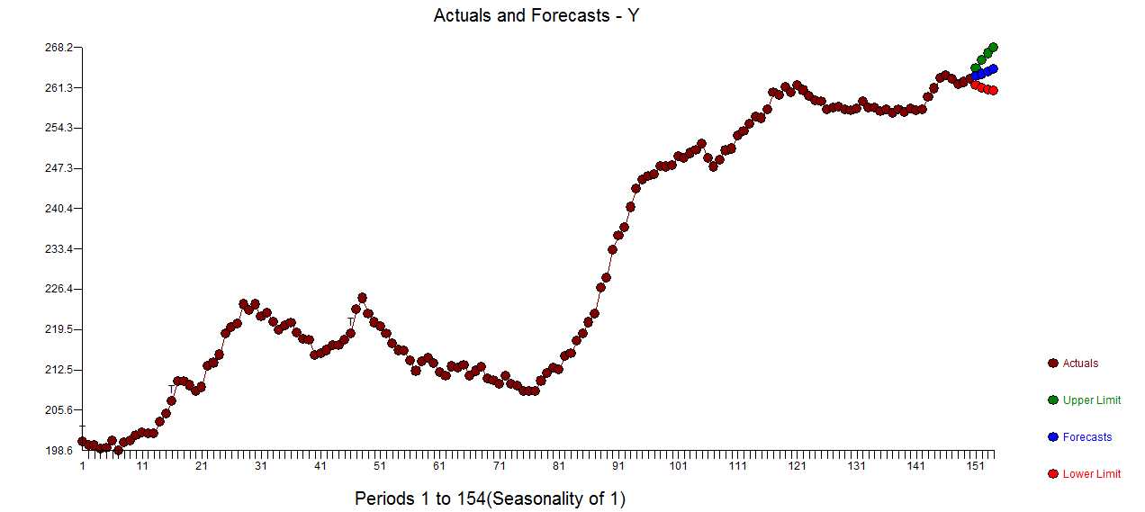
A time series model

Slide 9
Two Standard Assumptions:
The Confidence Intervals will take into account the variance of the model errors. (N.B. not the individual errors)
Auto-projective dependence on previous forecasts is incorporated for multi-period forecasts using the ψ-weighted method of interval creation.

Slide 10
Confidence Interval Creation
Variance: var(ŷ)
Standard Errors: se(ŷ)
Confidence Interval: ŷ$±t_{α/2}se(ŷ)$
Amounts to:
CI = ŷ$± se(\text{ŷ})∗1.504∗1.28$
Forecast $±$ (Std. Err.) * (4-per out ψ) * (80% Critical Value)

Slide 11
It all stems from the ARIMA estimation process
Computing the psi weights:

Slide 12
Moving Forward
A unified approach is to require an error distribution that is normal (no fat tails) while allowing for forecast uncertainties to be based upon an error distribution with fat tails. In this case, your outlier will not skew the coefficients too much. They'll be close to the coefficients with an outlier removed. However, the outlier effects should be considered in the forecast error distribution. Essentially, you'll end up with wider and more realistic forecast confidence bands.

Slide 13
A Quick Refresher!
Photo Credit: Viktor Hanacek

Slide 14
Standard Regression

Slide 15
The Standard Regression: Confidence Interval Creation
Variance: var(ŷ)
Standard Errors: se(ŷ)
Confidence Interval: ŷ$±t_{α/2}se(ŷ)$
Incorporates standard errors (uncertainty) of the coefficients

Slide 16
Three Unstated Assumptions:
Estimated model parameters are presumed to be the global parameters.
We are not accounting for uncertainty in future values for causal input series. This only applies to causal models.
Anomalies are not expected or accounted for in the future.

Slide 17
Some more Refreshments!

Slide 18
Refresher: Causal Modeling with OLS
A Simple OLS Model
Contemporaneous effects only, no lags.
Y(t) = a + b*X(t)
Or maybe you recall:

Slide 19
Refresher: Causal Modeling with TFs
Generally more robust to stochastic patterns.
Practically an aggressive form of ARIMA incorporating supporting series.

Slide 20
Because they can look like this:

Slide 21
Business Case Overview

Slide 22
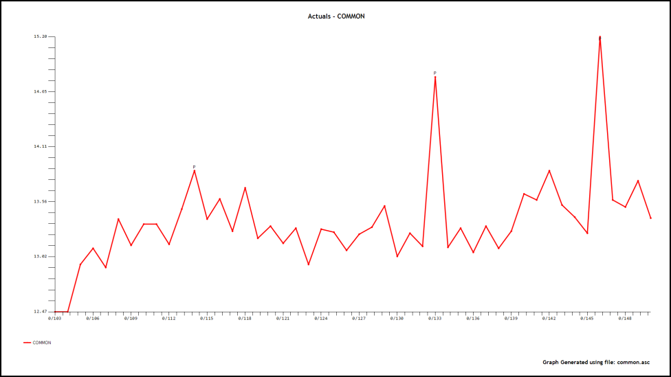
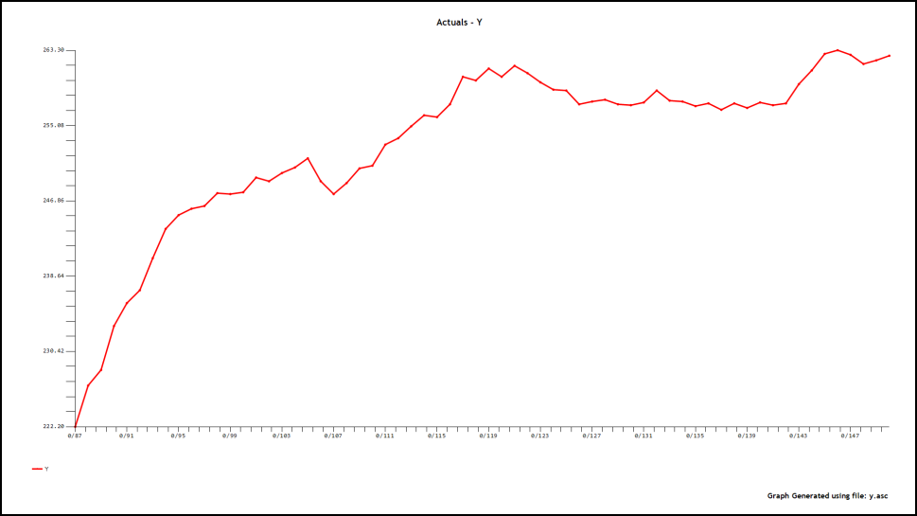
Business Case: Meet The Players
Sales (Y)
The Price of Oil (XCOMMON)

Slide 23
The Standardized Plot

Slide 24
The Price of Oil (XCOMMON)
Demand Planners at DepotCo are planning a product launch.
They would like to determine the feasibility of this action, given market conditions.
Market research tells them that the price of oil is a determinant of whether or not they can enter the market unimpeded.
We will perform three univariate analyses to model/predict the behavior of X.

Slide 25
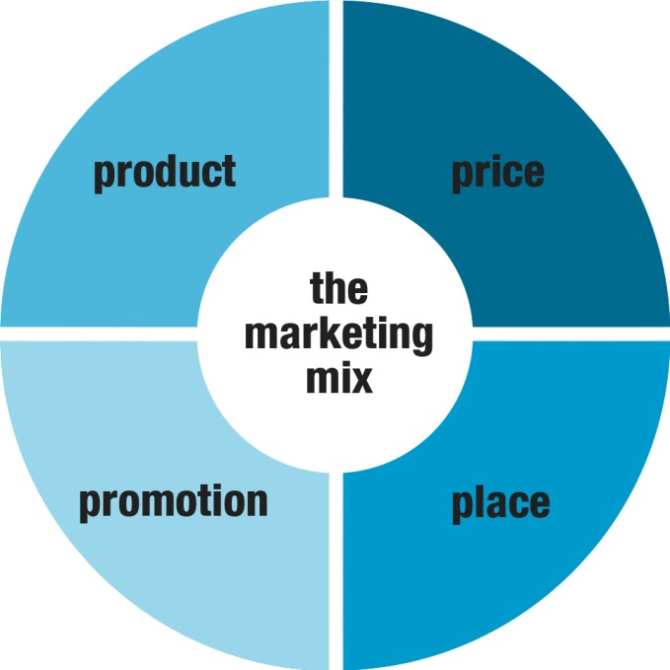
OR The Impact of a Marketing Forecast on Expected System Performance
Marketing Department Planners at XYZ Cellular are providing estimates for the number of future customers based upon promotions and product life cycles .
System performance depends critically on the number of customers.
How to incorporate the uncertainty in the exogenous forecast of the number of customers .

Slide 26
Business Case Part one
A Univariate Example for the price of oil.

Slide 27
The Scenarios We Will Use
We will show three different methods of dealing with
the assumptions that were previously mentioned
(i.e. global parameters, CIs reliance on ψ-weights,
and that outliers will not happen in the future)
Approach | Description
The Regular Case (A) | No adjustment for the 3 assumptions.
The Resampled Case (B) | Model errors are incorporated.
The Robust Case (C) | Model errors and outliers are considered.

Slide 28
Predicting the Predictor(A)
Basic ARIMA Incorporating Outliers using the Psi Weights

Slide 29
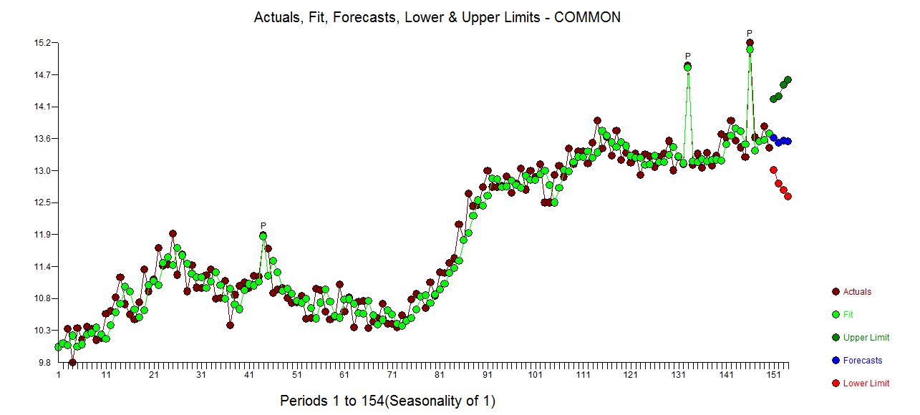
Predicting the Predictor(B)
Adjusted for model errors with Probability Sampling
i.e. Resampling model errors to enable uncertainty in the parameters.

Slide 30
Predicting the Predictor(C)
Used Probability Sampling to incorporate model errors as well as the possibility of future outliers.

Slide 31
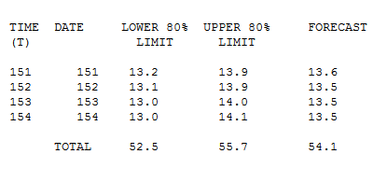
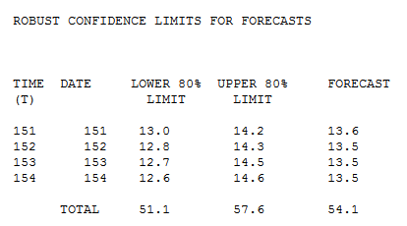
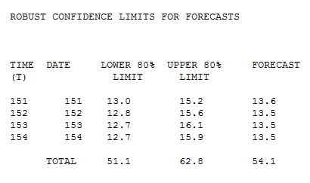
(A)
(B)
(C)

Slide 32
COMPARISON OF FORECAST TABLES FROM (A) AND (C )
Regular Case (A)
Robust Case (C)
Notes:
Fix for size

Slide 33
Comparing Simulated Residuals for (C)
Provides a discrete basis for comparison.
May help us prove/disprove error normality.
Recall:
Ψ-weighted Moving Averages
CI = ŷ$±t_{α/2}se(ŷ)$
Notes:
Remove residual series

Slide 34
Comparing Simulated Residuals for (C)
Notes:
Remove residual series

Slide 35
Business Case Part Two
Let’s Consider a Qualitative Example.

Slide 36
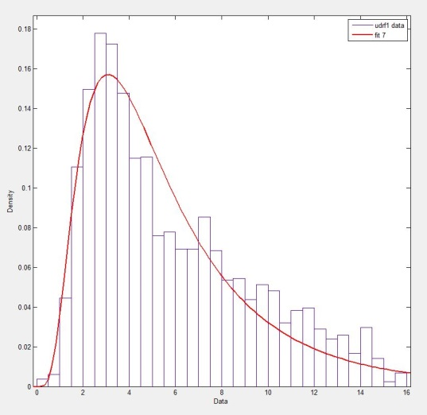
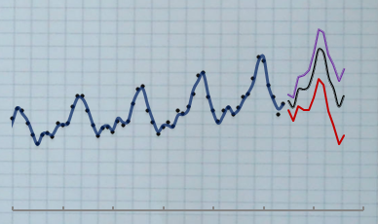
Step 3: Work PDF into Model
Build a model for the series
Generate a distribution based on PDF containing SME input – this represents their qualitative analysis.
Resample from distribution.
Incorporate pseudo-qualitative confidence interval into model.

Slide 37
Business Case Part Three
Let’s do some causal modeling

Slide 38
Sales (Y)
DepotCo wants the model for sales to include the price of oil.
Using the three univariate cases for X from before, we will provide potential scenarios to help drive their business decisions.

Slide 39
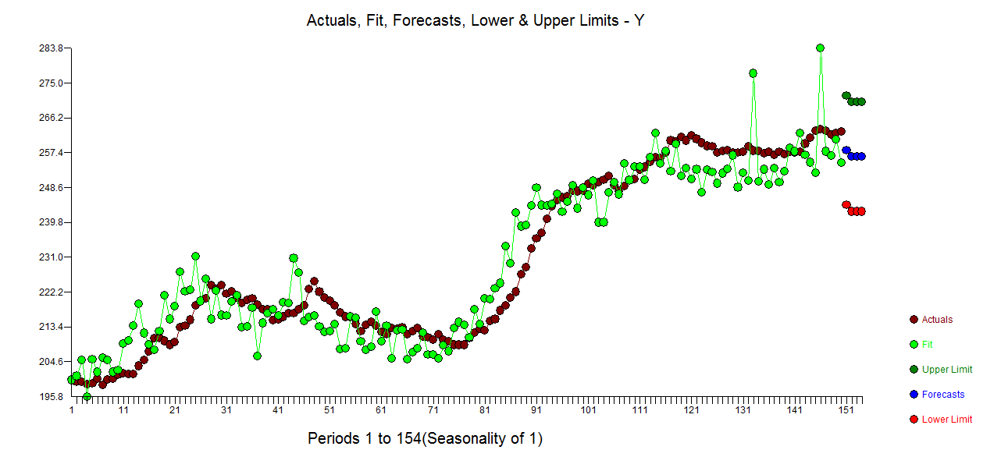
OLS between X and Y for Comparison
No probabilistic methods were employed. Fixed forecasts for the next 4 periods were used , from (A)
Notes:
Shouldn’t use OLS or fixed vector

Slide 40
OLS with Fixed Input Forecasts from (A)
This should serve as a gentle reminder as to the nature of causal modeling with OLS.
The future values for X are pre-specified, because of prior analysis.
Forecasts for X are dejected from the analysis which created them.
With no uncertainties around the forecasts, the values for X are ultimately a vector.
In short, the uncertainties in variable X are unaccounted for in the analysis of Y.
Both fixed-input forecasting and OLS can be a bad move.
Notes:
Fifth bullet point – don’t use OLS

Slide 41
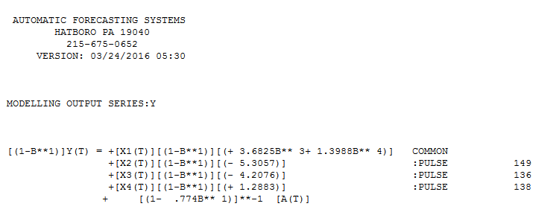
Transfer-Function (ARMAX) Solution
Our Model:

Slide 42
The Regular Case: Transfer-Function X(A)|Y
Regular case using ARMAX generates less model error and the ψ-weighted method of interval creation leads to potentially unreasonably tight values.

Slide 43
The Resampled Case: Transfer-Function X(B)|Y
Incorporating uncertainty in X leads to a wider probability space. Pulses have not been resampled from X.

Slide 44
The Robust Case: Transfer-Function X(C)|Y
Resampling with errors in X as well as outlier impacts leads to a wider CI that is more representative the uncertainty within X as Pulses are included in the resampling.

Slide 45
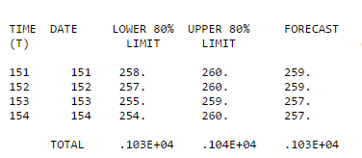
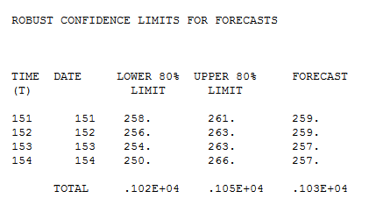
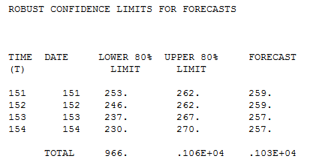
The Regular Case (A)
The Resampled Case (B)
The Robust Case (C)

Slide 46
DepotCo Consults with Industry Experts
In order to have a better understanding of their causal variables, DepotCo decides to consult with industry experts.
These functional SMEs have qualitative opinions that can improve DepotCo’s analysis.
How do we incorporate industry knowledge into the existing analysis?
Photo credit: Sebastiaan ter Burg

Slide 47
Step 1: Collect SME knowledge
DepotCo hires SMEs for input.
They interview experts for knowledge gathering.
Request that their analysis be numerical in nature– containing a component where their assessment comes down to probability.
i.e. What is the percent chance of a $1.00 increase in price? What about 50¢? A 10¢ decrease?

Slide 48
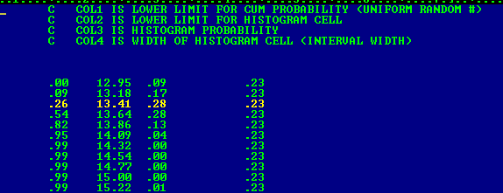
Step 2: Establish probabilities of certain outcomes based on their knowledge.
PDF – Probability Density Function

Slide 49
Reflection
What have we learned?

Slide 50
We have learned…
There are explicit and implicit assumptions in Confidence Interval creation:
It will take into account the variance of the model errors.
Auto-projective dependence on previous forecasts is incorporated for multi-period forecasts using the ψ-weighted method of interval creation.
Estimated model parameters are presumed to be the global parameters.
We are not accounting for uncertainty in future values for causal input series. This only applies to causal models.
Anomalies are not expected or accounted for in the future.
We can defeat the negative effects of these assumptions by incorporating probabilistic sampling methods into our modeling process.
We can incorporate model errors, outliers, and even qualitative inputs into these intervals.
Resampling can help model causal behavior more accurately, by allowing for uncertainty in the causal variables. Previous methods do not allow for this.
There is no harm in doing this, because if the resampled results are non-normal, we have learned more about our dataset. If they are normal, we lose nothing.

Slide 51
Any Questions?

Slide 53
Photo Credits
https://goo.gl/HW1vdw
http://temporausch.com/01/
https://www.viktorhanacek.com/
https://www.flickr.com/photos/ter-burg/
http://www.gratisography.com/
Notes:
Leaf

Slide 54
Comparing Model Residuals to Simulated Residuals for TF(C)

Slide 55
A unified approach is to require an error distribution that is normal (no fat tails) while allowing for forecast uncertainties to be based upon an error distribution with fat tails. In this case, your outlier will not skew the coefficients too much. They'll be close to the coefficients with an outlier removed. However, the outlier effects should be considered in the forecast error distribution. Essentially, you'll end up with wider and more realistic forecast confidence bands.

Slide 56
Agenda
We Can Do Better
Why This is the Case
How We Can Improve
The Probabalistic Solution
How this is Accomplished
Walkthrough
Q/A

Slide 57
We can do better than we are currently doing.

Slide 58
<Poor Performance. jpg>

